Slide 1
Tutorial 3
Fall 2025

Slide 2
Form Basics

Slide 3
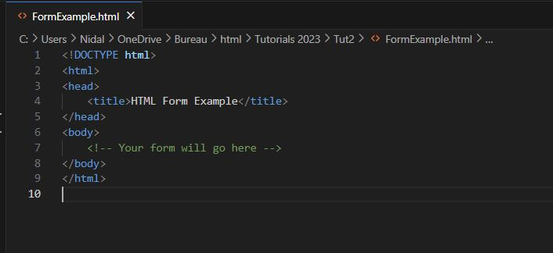
1. Setting up the HTML Structure
Head
HTML
Body

Slide 4
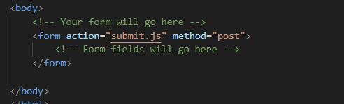
2. Creating the Form Element
Inside the <body> element, add the <form> element to create your form.
The action attribute specifies where the form data should be sent when submitted
The method attribute defines how the data is sent (usually 'GET' or 'POST').

Slide 5
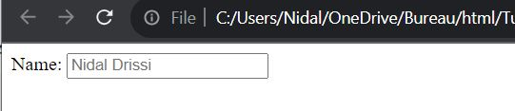
3. Adding Form Fields
Text Input
Identifier of the field. Required to identify and use the information sent in the field to the backend
What would be written in the field as an example

Slide 6

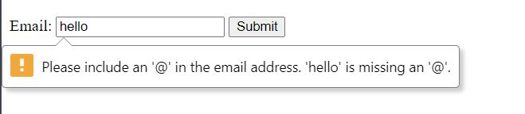
3. Adding Form Fields
2. Email Input
Type “email” will require the user to follow the appropriate email form

Slide 7

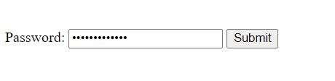
3. Adding Form Fields
3. Password Input
Type “Password” will hide what the user is typing

Slide 8
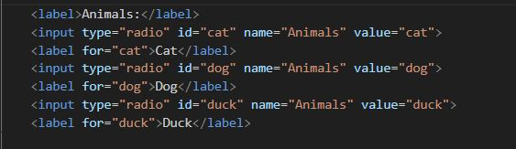
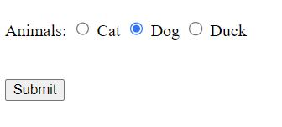
3. Adding Form Fields
4. Radio Buttons
Type “Radio” creates a selectable item
Giving “radio” the same “name” attribute, will allow the selection of only one option of the group. When you select one the other will be deselected automatically
The information sent to the backend is the value of the attribute “value” and NOT the label

Slide 9
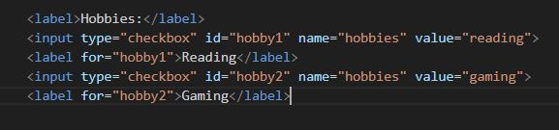
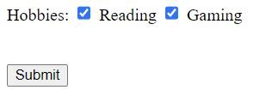
3. Adding Form Fields
5. Checkboxes
Type “Checkbox” creates a selectable item
The information sent to the backend is the value of the attribute “value” and NOT the label
Multiple checkboxes can be selected. Unlike type “Radio”

Slide 10
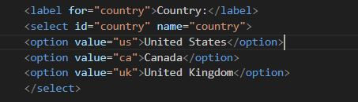
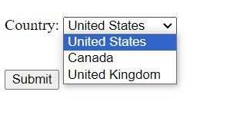
3. Adding Form Fields
6. DropDown Menu
The “Select” element creates a dropdown list
The “Option” element creates the options inside the list
Only one option could be selected

Slide 11

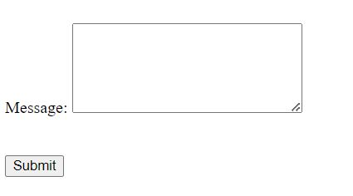
3. Adding Form Fields
7. TextArea
The “textarea” element creates a large writing space. Suitable fo comments, messages, etc

Slide 12

4. Submission Button
Type “submit” creates a button. Clicking the submit button triggers the form action

Slide 13
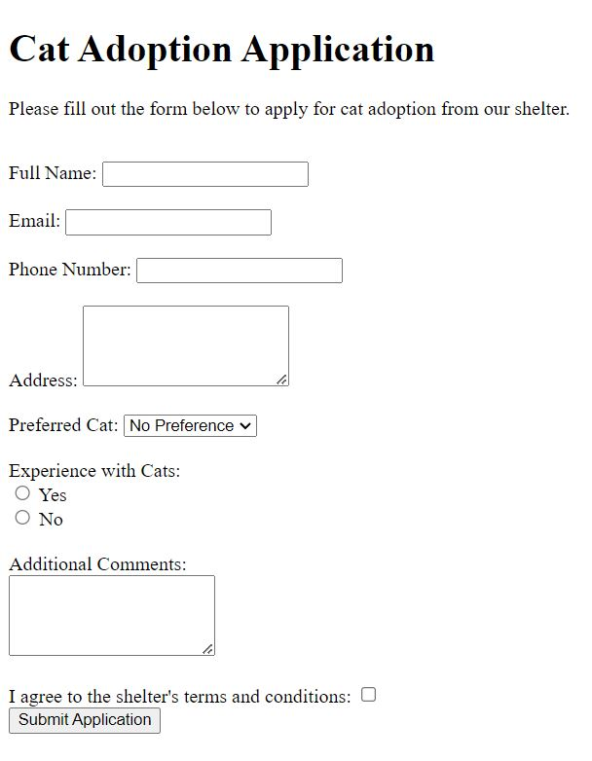
Exo 1: Create the following form

Slide 14
CSS Basics

Slide 15
What is CSS
CSS (Cascading Style Sheets) is a style sheet language used to describe the presentation of a document written in HTML. It controls how HTML elements are displayed on a webpage, including layout, colors, fonts, and spacing.
CSS is NOT a programming language

Slide 16

How to Include CSS in HTML
Inline CSS
Internat CSS
External CSS
1.1 Inline CSS: Apply styles directly to an HTML element using the style attribute. It's not recommended for large-scale styling.

Slide 17
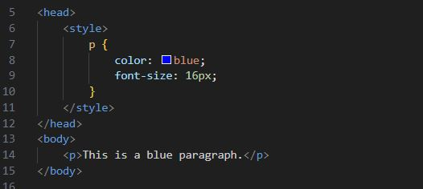
How to Include CSS in HTML
Inline CSS
Internat CSS
External CSS
1.2 Internal CSS: Define styles within the <style> element in the document's <head> section.

Slide 18
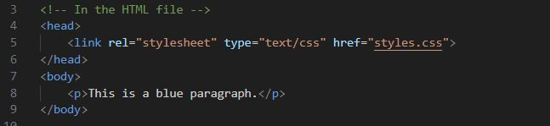
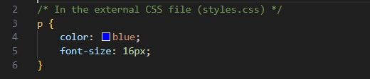
How to Include CSS in HTML
Inline CSS
Internat CSS
External CSS
1.3 External CSS: Create a separate .css file and link it to your HTML document using the <link> element.

Slide 19
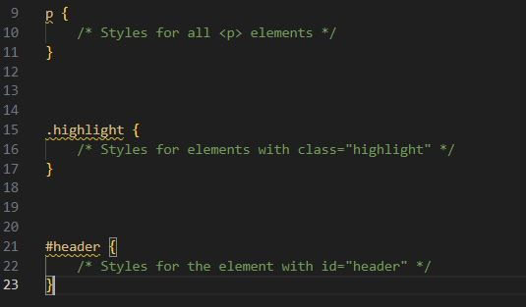
2. Selecting HTML Elements
Type selector
Class selector
ID selector
2.1 Type Selector: Selects elements by their HTML tag name.
2.2 Class Selector: Selects elements with a specific class attribute.
2.3 ID selector: Selects a single element with a specific ID attribute.

Slide 20
3. Some CSS elements
-color: Sets the text color.
Example: color: red; makes the text color red.
-font-family: Specifies the font for text.
Example: font-family: Arial, sans-serif; sets the font to Arial or a sans-serif backup.
-font-size: Defines the size of the font.
Example: font-size: 16px; sets the font size to 16 pixels.
-font-weight: Determines the thickness of the font.
Example: font-weight: bold; makes the text bold.
-text-align: Aligns text within its container.
Example: text-align: center; centers the text within its container.
-text-decoration: Adds decoration to text (e.g., underline).
Example: text-decoration: underline; underlines the text.
-background-color: Sets the background color of an element.
Example: background-color: #f0f0f0; sets the background color to light gray.
-margin: Controls the space outside an element.
Example: margin: 10px; adds a 10-pixel margin around an element.

Slide 21
3. Some CSS elements
-padding: Adjusts the space inside an element.
Example: padding: 20px; adds 20 pixels of padding inside an element.
-border: Defines the border around an element.
Example: border: 1px solid #ccc; creates a 1-pixel solid border with a light gray color.
-width: Sets the width of an element.
Example: width: 300px; sets the element's width to 300 pixels.
-height: Specifies the height of an element.
Example: height: 200px; sets the element's height to 200 pixels.
-display: Determines how an element is displayed.
Example: display: inline-block; makes an element an inline block-level element.
-float: Floats an element to the left or right within its container.
Example: float: left; floats the element to the left.
-position: Defines the positioning method for an element.
Example: position: absolute; positions the element absolutely within its closest positioned ancestor.
-top, right, bottom, left: Adjusts the position of an element when used with the position property.
Example: top: 10px; moves the element 10 pixels down from the top.
-border-radius: Rounds the corners of an element.
Example: border-radius: 5px; creates 5-pixel rounded corners.
-box-shadow: Adds a shadow effect to an element.
Example: box-shadow: 2px 2px 4px #888888; creates a subtle box shadow.

Slide 22
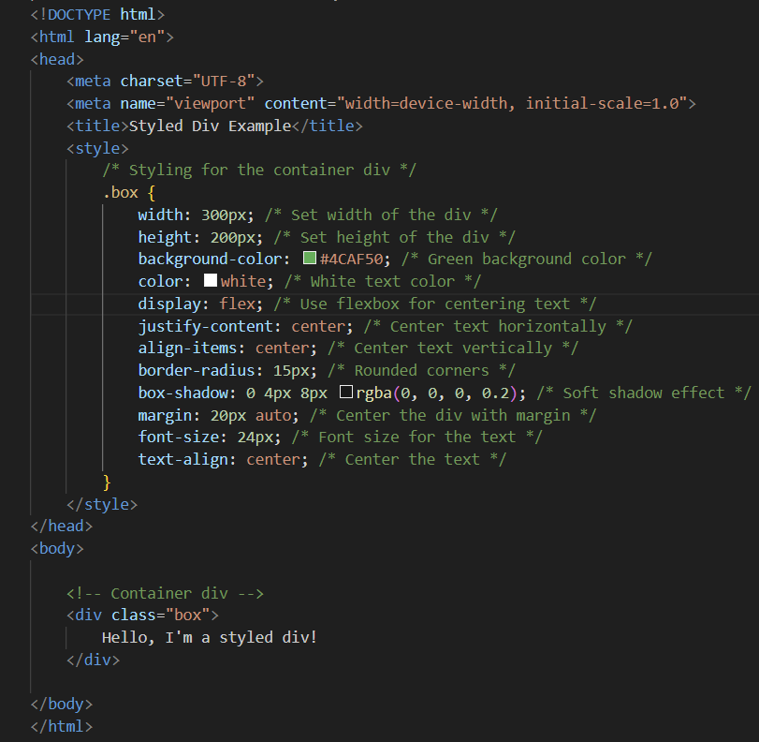
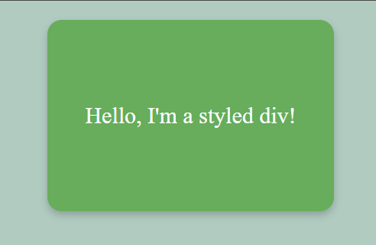
Example:

Slide 23
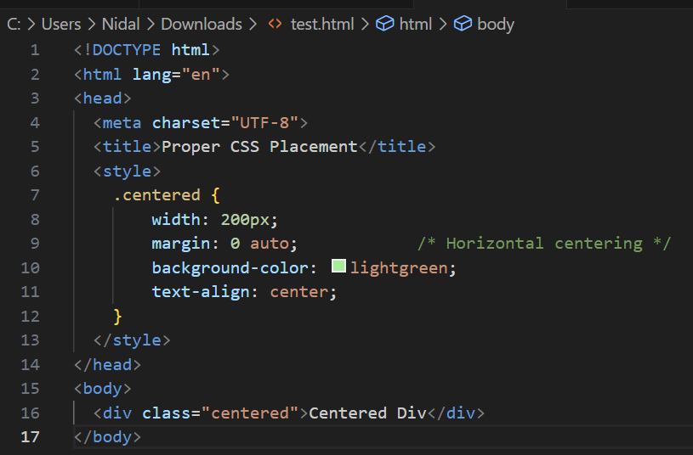
Simple way to center a Div

Slide 24
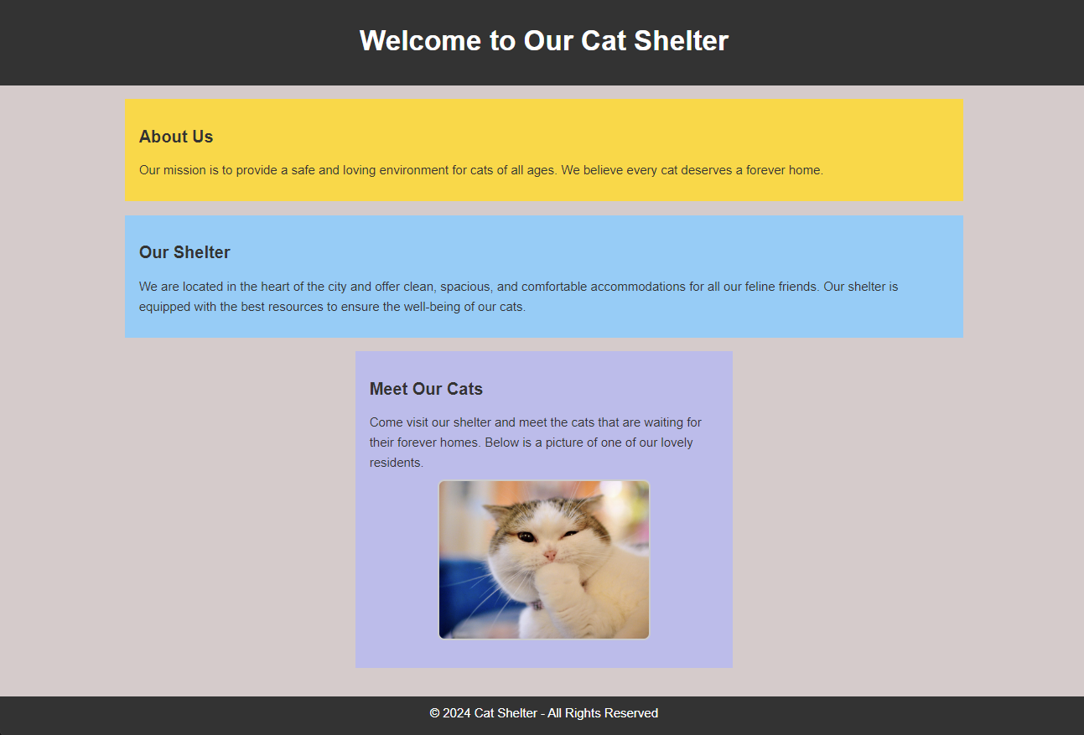
Exo2: Try to remake this example using CSS and HTML

Slide 25
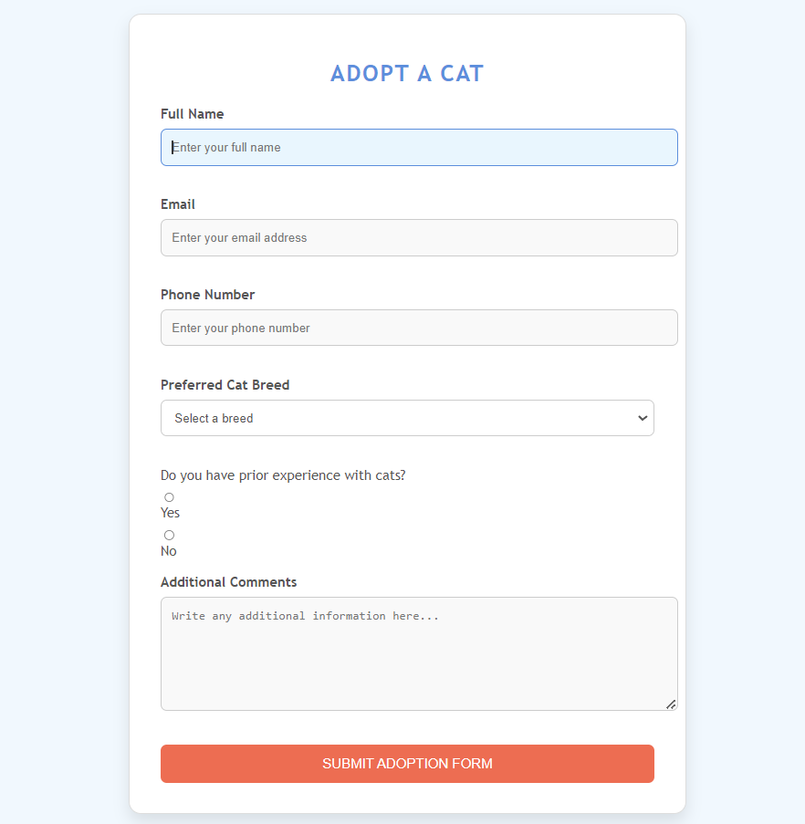
Exo3: Try to remake the form you created earlier with some CSS style adjustments

Slide 26
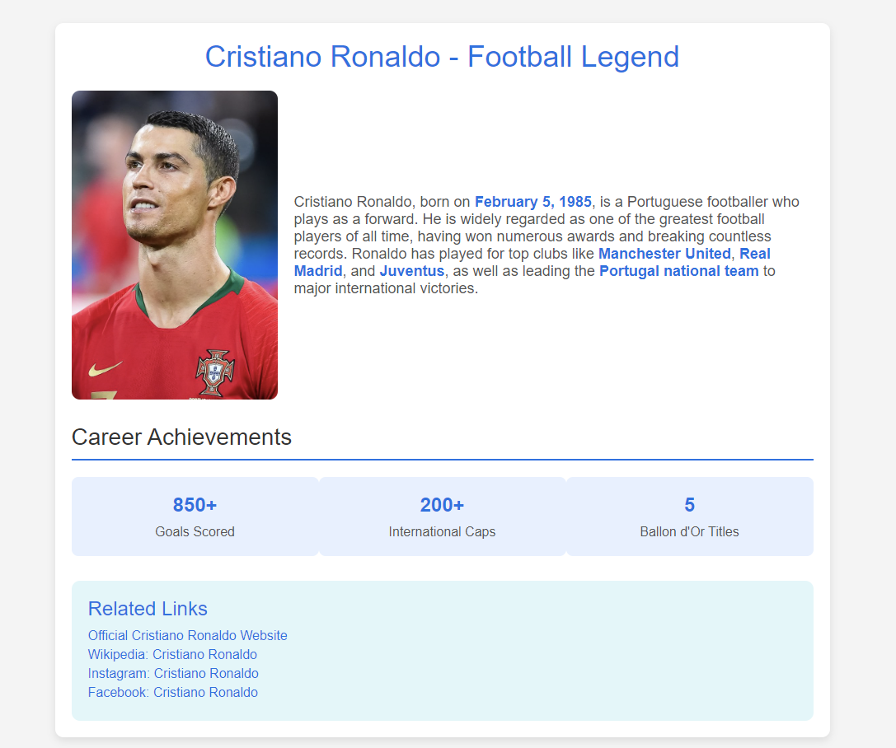
Exo4: If you’re a Cristiano or a CSS fan. Try to make this page

